Slide 1
Science Jargon
Understanding the usefulness of science
Cody Conner

Slide 2
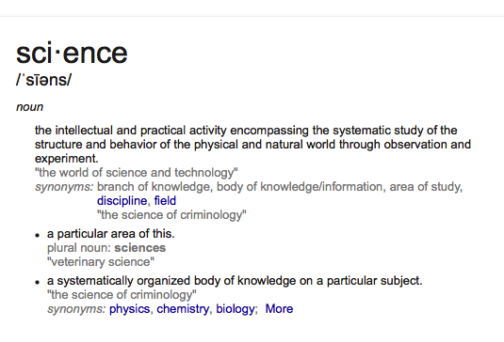
Science

Slide 3
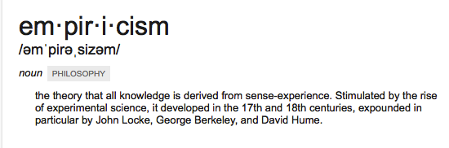
Science
Science is therefore studied empirically
Empiricism

Slide 4
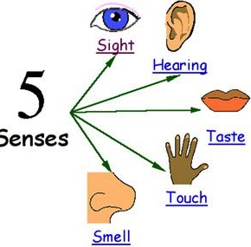
Empiricism
In general it is defined as the process of acquiring knowledge through experience and observation.
Empirical Knowledge would therefore be knowledge base on the senses and the experiences of the world.
Notes:
Read Slide

Slide 5
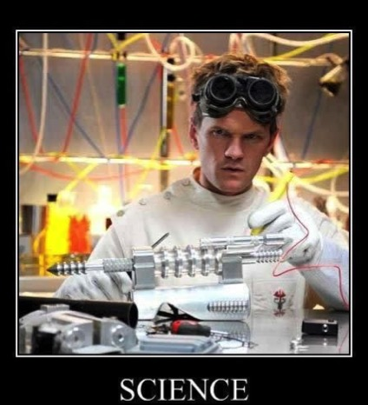
Empiricism & Science
What’s this got to do with science?
Empiricism - central building block
How do you science?
Notes:
Despite its issues Empiricism is the central building block of how we science so We science through observation using the 5 senses and recording it. Science is described as a process of systematic gathering and evaluating empirical evidence to answer questions and Ideas. In other words we gather the empirical evidence according to some plan, and evaluate it using reasoning in order to answer questions and ideas.

Slide 6
More Empiricism & Science
SO What does this have to do with science?
With everything there are issues
Personal Experiences differ
Perceptions
Notes:
When we actively conduct research we do not solely rely on empiricism as it does have some limitations. First of all none of us experience everything in this world that there is to experience, this means that each of our own personal experiences differ as well as our perceptions. So let’s say each of did experience the exact same event or we are looking at the the exact same tree.

Slide 7
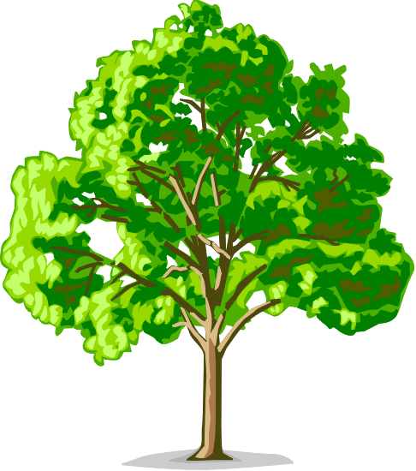


Perception
Notes:
A tree such as this. There are two people looking at the same tree but on different sides. The tree, as we can agree is just one single tree but it may be different on different sides. So even though they are viewing the same tree they may not have the whole tree in mind thus this is their perception. Think of it in the same way you may think of a coin, there is more than one side but you can not see both sides at once.

Slide 8
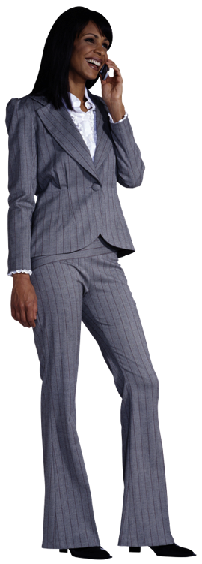

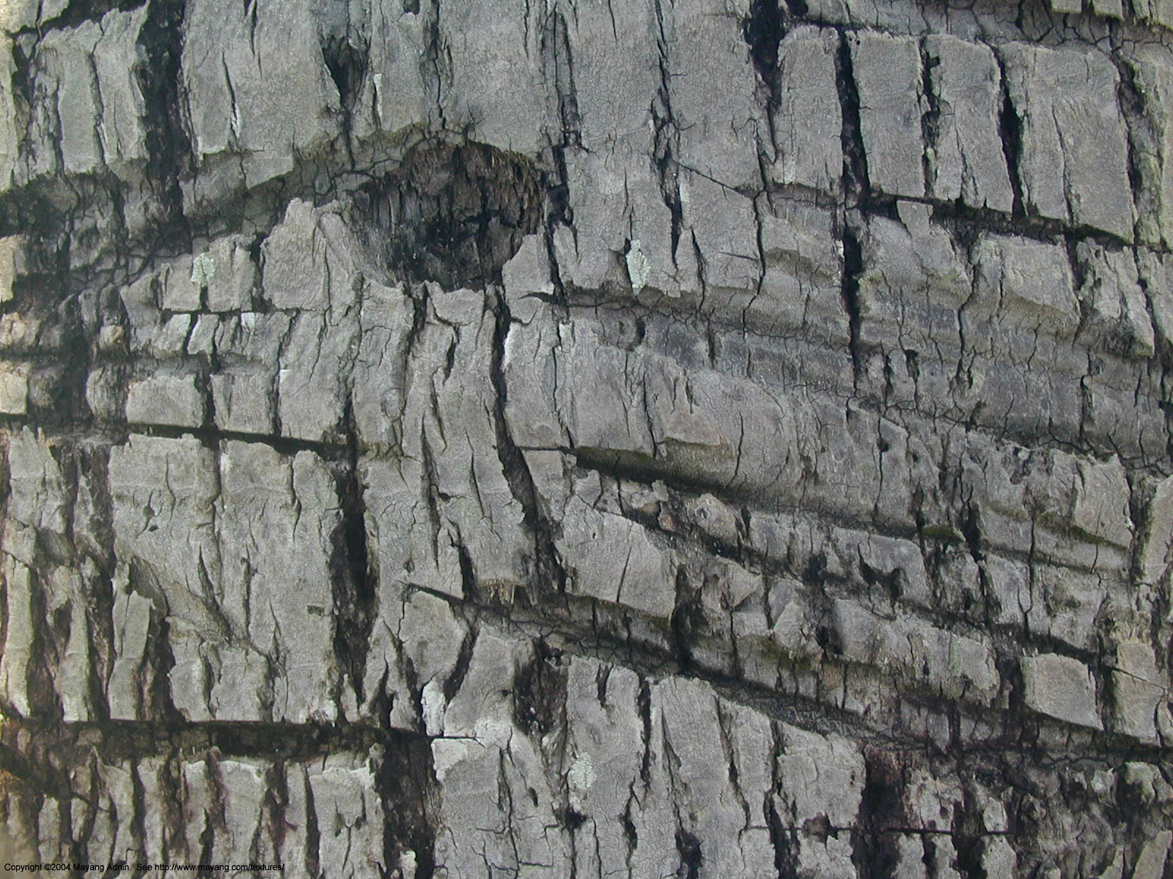

Personal Experiences
?
Notes:
Personal experiences can also effect how we might perceive things. Let’s break this down a little bit. So we have this woman here. Will create a little background on her. She is an environmentalist that has worked hard to inhibit the destruction of the rainforests. See she’s on the phone now trying to save more trees. Good for her.
Well how does this experience effect how she perceives her side of the tree? Well she works hard to protect them so she may be more inclined to notice things such as names carved into the tree or perhaps, ax or saw marks, maybe even animal marks. So her experience has an effect on her perceptions.

Slide 9
More Empiricism & Science
SO What does this have to do with science?
With everything there are issues
Personal Experiences differ
Perceptions
Confirmation Bias
Notes:
Then there is also this fun little thing known as the confirmation bias.

Slide 10
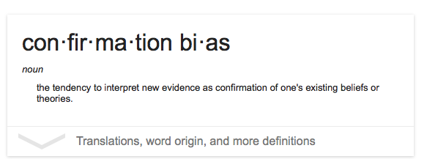
Confirmation Bias
Notes:
Confirmation bias is defined as the tendency to interpret new evidence as confirmation of one’s beliefs or theories. So lets think back to the tree.

Slide 11
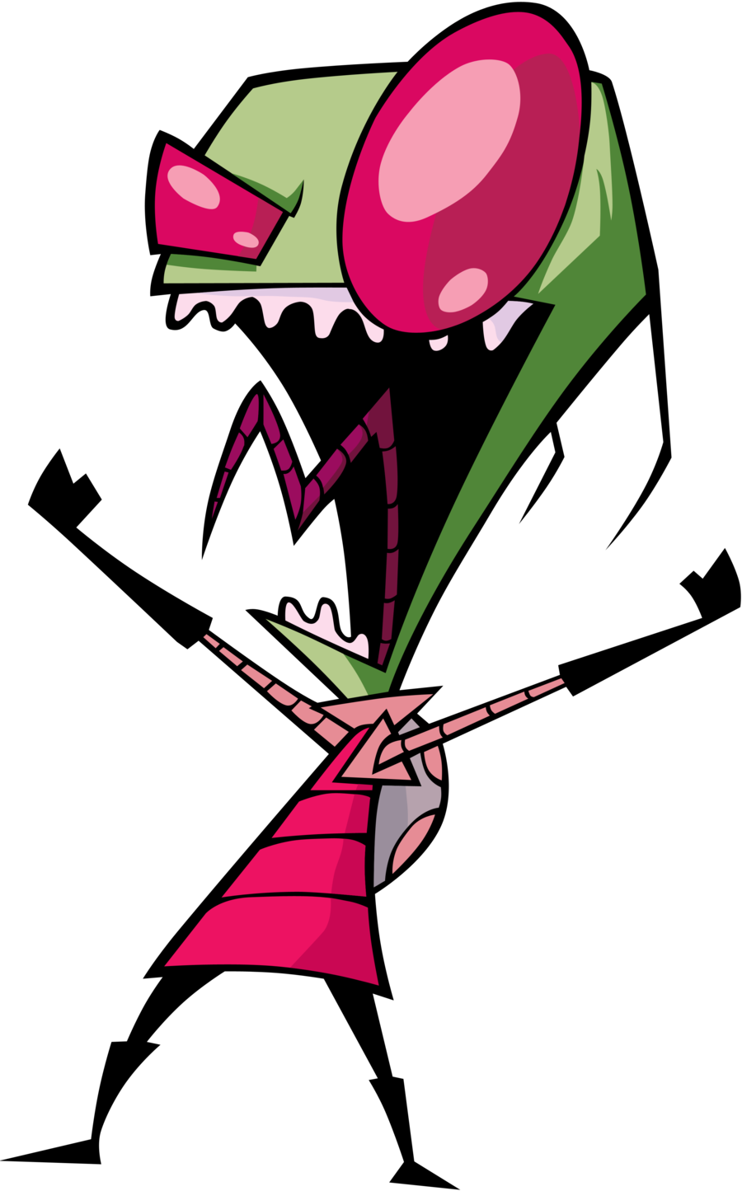
Perception
Notes:
This Tree! Ok, so the way to think of it is this guy is more likely to seek out others that share his view of this side of the tree to confirm what he saw. Like this little guy here. He has only seen this side of the tree as well and will confirm everything the first guy saw by sharing his experiences with this suit guy. Now what this suit guy should do is move to the other side of the tree to see what is there and talk to the woman about what she sees to get a more full view of the tree. Make sense?

Slide 12
Now What?
Ok we have the basic idea of what science is what do we do with that?
Notes:
What do we do now that we have such great and powerful knowledge on such a process??
Well let us talk about that

Slide 13
Explanations
Science is used to explain things
Ex. Decay effects (Peterson & Peterson, 1959)
Remember sets of letters and numbers
GTH 743
Count back by 3s from a number
Prevents rehearsal
Demonstrates Decay
Also Demonstrates interference
Notes:
Since we now have this ability to examine things in a systematic way let’s discuss a study or two.
In a task that is now referred to as the Brown Peterson task Participants presented with three letters and number then asked to count backwards by threes, this was done to prevent rehearsal, they were then asked to recall the numbers after varying delays. Since the numbers cannot be rehearsed by using this method, the Peterson researchers found that the greater the delay the less numbers are remembered. This is what the researchers decided was decay in short term memory. The Peterson’s found support for their claim by repeated trials. This may very well be true. Brown then reanalyzed the data and found support for interference. When the data was Re-analyzed, it was found that there was decent recall after delays that were early in the experiment suggesting Information not necessarily decaying, but info could be building up from each trial making recall difficult in later trials, implying Interference is cause of short duration, not decay.
Interesting right? Well you may not think so but that is not the point.
We reviewed a bit of research to illustrate a simple point but before I say exactly what that is let’s talk about my favorite phrase in my undergraduate research.

Slide 14
The Phrase?
Correlation
DOES NOT
equal causation!
Notes:
This phrase was used in my undergrad practically daily in the psychology department and that phrase is “correlation does not equal causation.” So you may know that there are ways to link cause in research but that is not what we are focusing on. This is meant to be a good general rule when it comes to finding support for research. So that is the point I’m trying to make here is that just because you found support for it does not make it fact.

Slide 15
Prove?
Notes:
Why does this matter? To address the use of the word prove. So what does this mean in terms of proof? Everything, under no circumstances do we ever use the word prove in reporting research. You might ask why this is so, but think back to the tree, she might prove that the tree has been attacked but the guy cannot as he did not see that side, and neither did Zim. This is also the same with the memory example, the first researchers may have thought they found proof for decay but as shown it can be something else too. Proof tends to indicate that there is no room to change or adapt and grow. There is also those issues we discussed in inherent in empiricism.

Slide 16
Not using Prove in Research
It creates this idea of finding the only answer
Rejecting the Null
What the heck is a null?
The Null Hypothesis
REJECT THE NULL!
Notes:
This leads me to another point on using this word: using prove would mean you found the end all, be all answer to whatever question lead you to the research in the first place. So as stated before it does not allow for change or adaptability. While you may think that you have done so, all it takes is one case, just one, against your answer to demonstrate that it doesn’t actually prove it.
Which is why we reject the null rather than prove the research hypothesis. What’s the Null hypothesis, you ask?
The null hypothesis usually refers to a general statement or default position that there is no relationship between the measured phenomena, basically it assumes there is no difference among groups. So by saying we reject the null we are saying we have support that says there is a difference.

Slide 17
Recap
Science is good
Use it for greatness
With great power comes great responsibility
NEVER SAY PROVE IN RESEARCH
We simple reject the Null Hypothesis

